Slide 1
From Dynamic Loading to Extensible Transformation:
An Infrastructure for Dynamic Library Transformation（OSDI22）

Slide 2
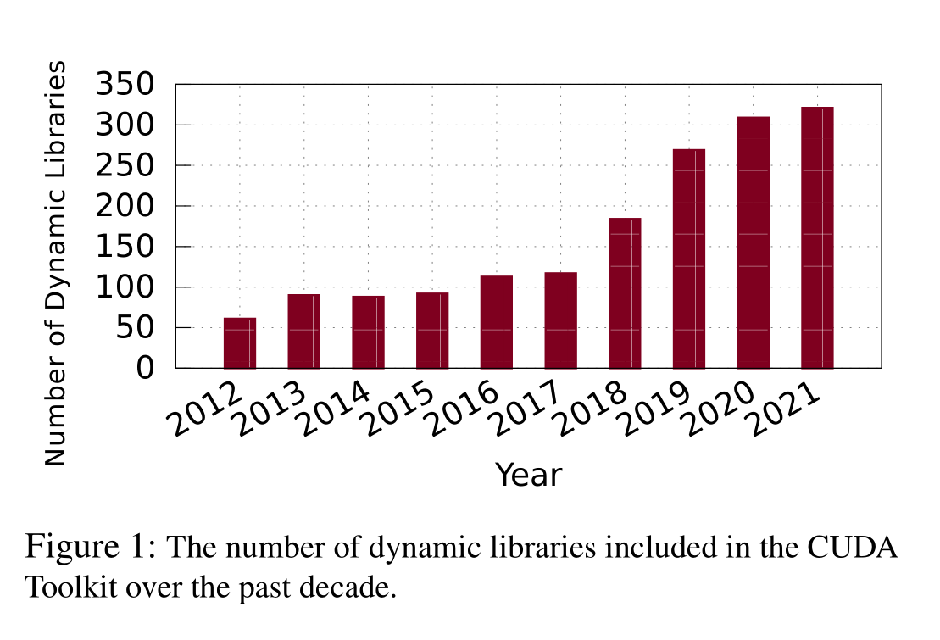
motivation
Avoid license contamination（许可证污染）
modern software needs frequent updates because of CVE fixes, bug fixes, or adding new features
break up software into many fine-grained dynamic libraries. Which lead to the massively increasing number of dynamic libraries used in an application

Slide 3
motivation
Hardware memory protection（Intel MPK and SGX）
Load time code randomization and binary rewriting
Verifies the signature of loaded binaries
Library debloating relies on the dynamic loader to examine and eliminate unused library code from program memory
Required to provide more features to make better use of emerging hardware and software technologies
Problem：
Need loader offer rich functionalities but ignored by academia and industry.
(e.g. Glibc)

Slide 4
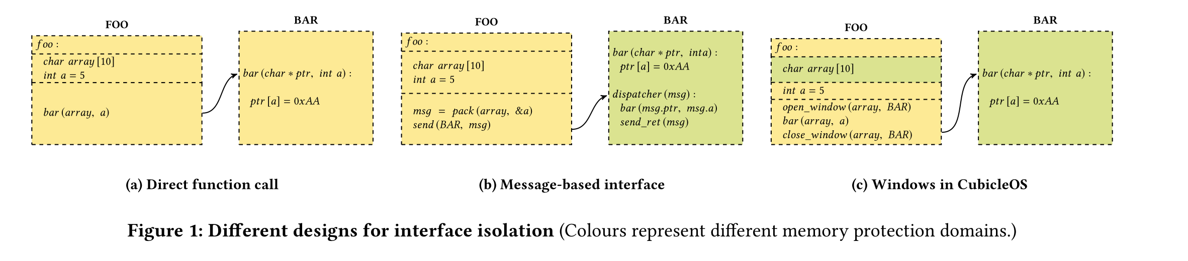
Example：CubicleOS
Based on Unikernel
Use MTK
Use a cubicle loader
Main Idea：
Open window before access and close window after access
CubicleOS: A Library OS with Sofware Componentisation for Practical Isolation(ASPLOS ’21)

Slide 5
Cubicle loader
（1）pages identified as code are given execute-only permissions, data pages are given read or read-write permissions (as specified by the binary), and CubicleOS does not allow cubicles to change the execution permissions of any page
（确定code代码和data代码的权限，不允许cubicle里面修改他）
（2）the loader scans the code pages to ensure that they do not contain any instructions that would affect the integrity of the isolation mechanisms, i.e., cubicles cannot directly execute system calls nor MPK-related operations.
（检查代码，不允许cubicle里面执行syscall和MPK相关操作）
CubicleOS: A Library OS with Sofware Componentisation for Practical Isolation(ASPLOS ’21)

Slide 6
iFed
Design Principles
Extensibility and Modularity
Flexibility and Customizability
Compatibility and Transparency
Functionality
Memory management
Isolation
Security enhancement
Binary rewriting and execution control
→ Passed-based dynamic library loader

Slide 7
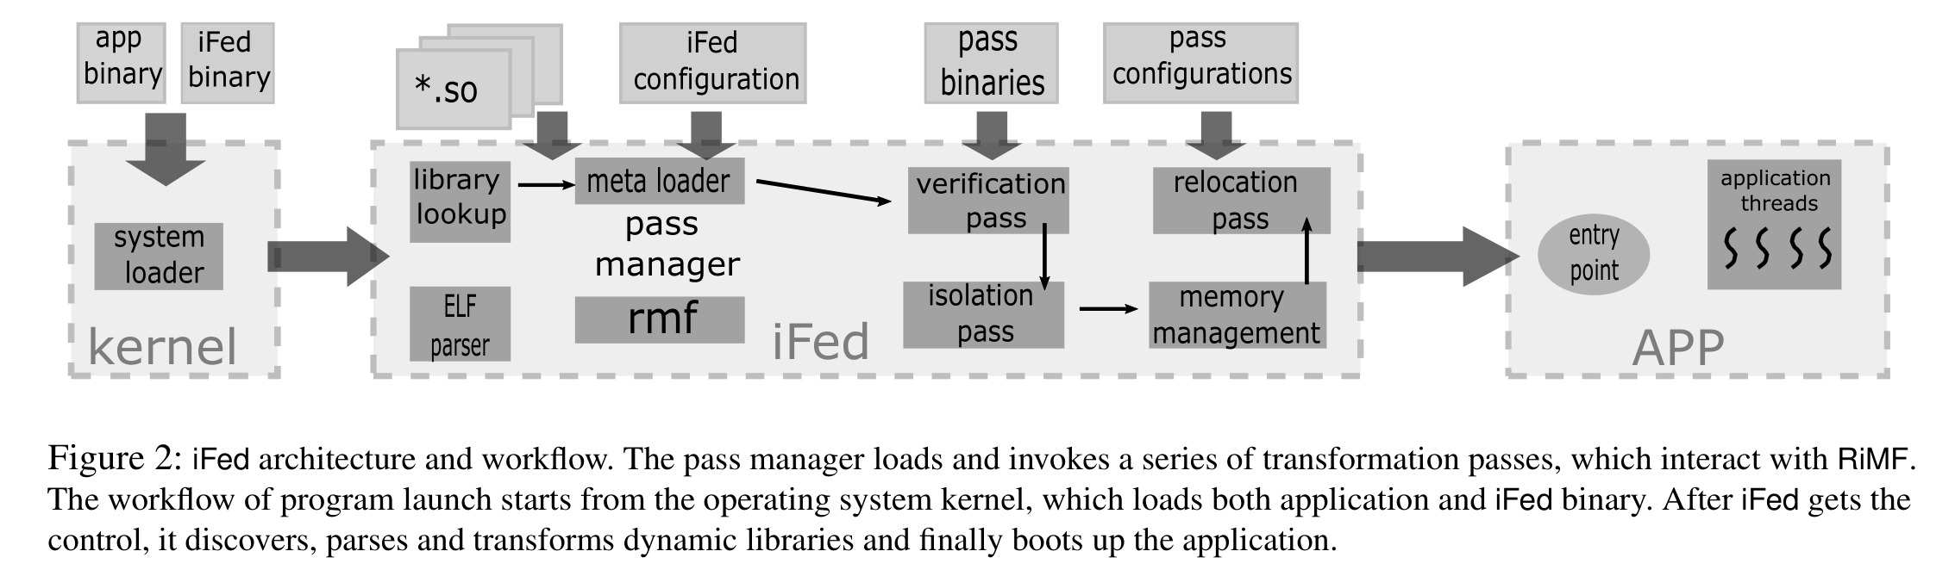
iFed

Slide 8
RiMF 中间表示
Pass与Pass之间通过RiMF（Runnable in-memory format）中间表示去进行传递，以及便于排列组合
RiMF
Entry Point
Isolation Domain
inter-domain invocations
that need to be resolved specially
Isolation Domain
……
Dynamic lib
……
Dynamic lib
Dynamic lib

Slide 9
RiMF 中间表示
每个隔离域内都维护一个table
memory-mapping tables which describe library address space layout and memory attributes
（内存属性和描述）
symbol tables dealing with symbol definition, binding, reference, and so forth
（符号表）
section metadata tables that associate RiMF sections to original ELF object files
Hint: A RiMF section does not contain the actual binary, but maps to one or more ELF sections initially

Slide 10
Pass管理器
Functionality
First, the pass manager maintains the RiMF image and provides interfaces to various passes to query and modify RiMF .
（管理RiMF和提供pass的调用接口）
Second, the pass manager acts as a meta loader, which loads and executes each transformation pass
（加载执行不同pass）
Pass顺序问题
Pass依赖和Pass冲突
（没有依赖的情况下）Pass的顺序问题（例如，二进制验证、 eliminate unused library code等Pass）
vDSO（一些pass本身依赖于vDSO的系统调用）

Slide 11
Pass管理器
Tips：
每个pass也被弄成一个动态链接库
兼容性，为了能和普通的加载方式兼容，现有的ld.so加载器当成一个特殊通道

Slide 12
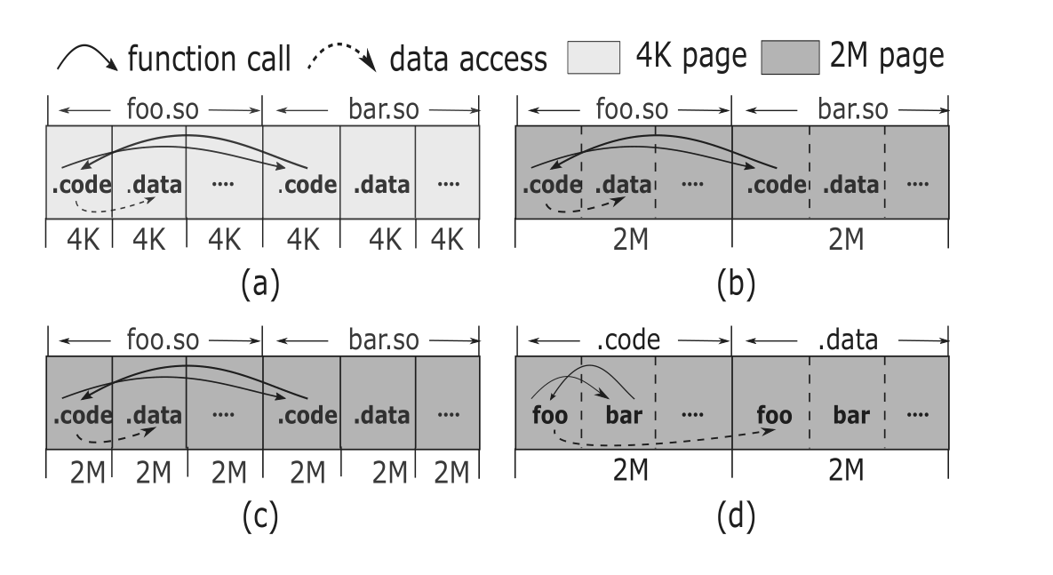
Some Example Pass
Problem： Performance of Huge Page
（a）啥都没有的情况
缺点：页面太小，tlb miss率高
（b）都使用2M的页
缺点：粒度太粗，所以.code段和.data段会获得同样的读写执行的权限。
（c）对于巨大的Library，使用巨大的页面
缺点：只对巨大的Library有用
（d）iFed的办法。把不同的库拼到一起去，确切的说是公共的部分。

Slide 13
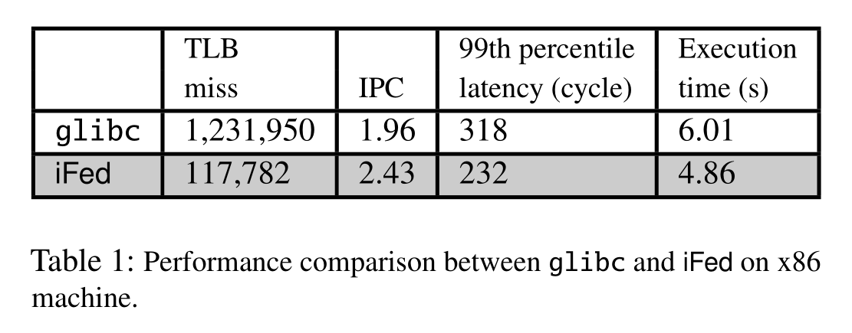
Problem： Performance of Huge Page
Glibc：单独把每个动态库去加载，并进行随机映射
iFed：把这些库公共的部分加载到大页中（当然如果公共的部分小于64K，依然放在小的页面中去）

Slide 14
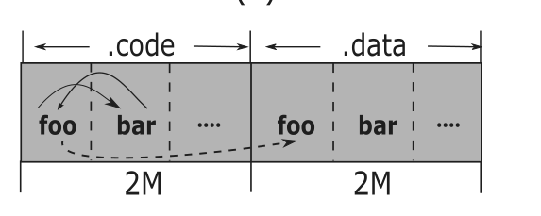
iFed：把这些库公共的部分加载到大页中
Problem：修复变量的访问
把.code段和.data重新组织之后，之前使用偏移方式访问变量的办法就失效了
作者的办法是
使用gcc的-emit-relocs选项获取所有符号信息
并且在pass中进行修复
（所以按这个说法，是需要重新编译动态库的吧）

Slide 15
Some Example Pass
库共享问题
动态链接库的一个作用是，多个进程使用同一个动态库副本，可以只在内存中保留一份。
但是经过pass修改之后，动态库本身已经发生了变化，无法再被其他进程共享复用。
(1) The shared region is mainly the immutable code section.
（就是说就算每个进程复制一份代码，其大小可以忽略不计，举得例子是glibc只有17M，但是服务器可以动辄几百个G的内存）
(2) we can apply library concatenation only to key applications
（因为兼容性，所以可以只对关键进程这么搞）
(3) In some cases, such as edge computing or micro-service, the same process will fork multiple times to serve different customers
（搞个模板，直接fork，这一系列进程，有相同的内存布局）
(4) In the extreme case where the library must be shared, we align sections from different libraries at the 4K boundary.
（最后没办法了，那就把它按照不同库的代码4k对齐）

Slide 16
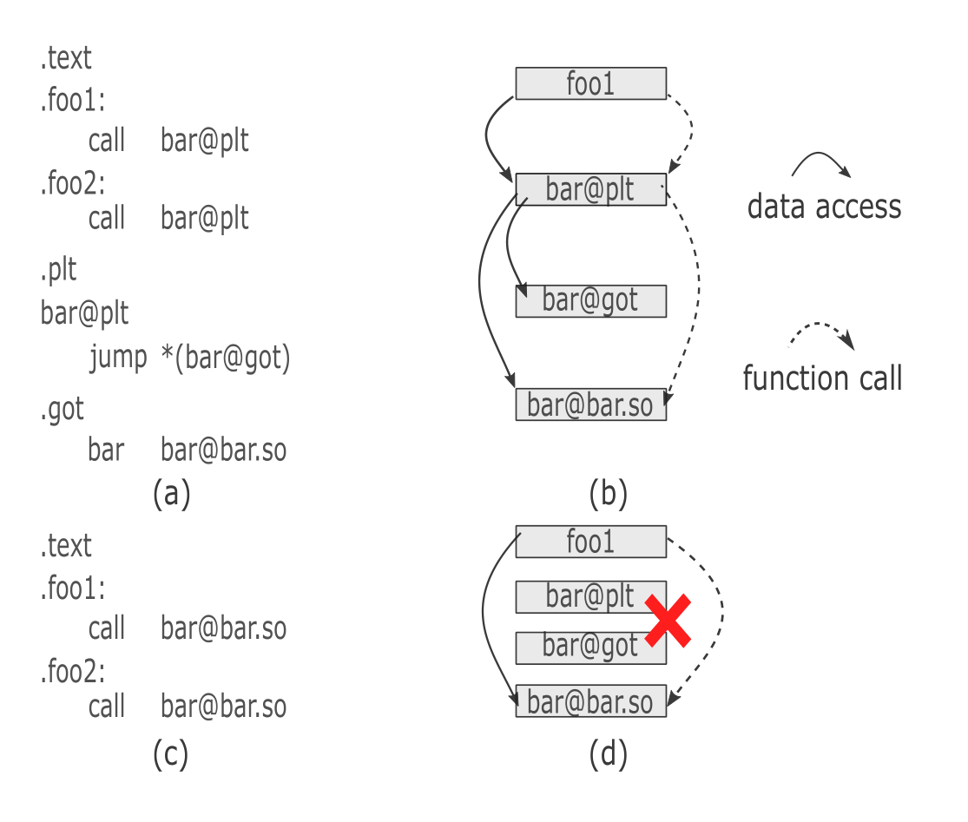
Some Example Pass
Relocation Branch Elimination
传统的动态链接库需要
应用程序→plt表→got表→目标
跨库之间调用开销
代码执行开销
分支预测开销
稀疏访问plt表的cache miss和TLB miss开销

Slide 17
Relocation Branch Elimination
解决方案
在iFed中加一个pass，解析之后，修改指令，直接填写目标地址
（非常简单的思路）

Slide 18
Relocation Branch Elimination
引入的问题：
1、相对寻址的距离限制
（1）When combined with the dynamic library concatenation pass, it is rare that the distance exceeds the architectural constraint.
（pass会处理这种情况，合理安排内存布局）
（2）We can change the relative addressing to absolute addressing mode at the cost of an extra instruction to load the address into a register. This change can be done by recompiling the code or rewriting the instructions by the loader.
（相对寻址直接改用绝对寻址，也就多一条指令）
（3）For the call sites that are far away from the target function, we can fall back to the existing relocation method using .plt and .got.
（实在不行继续用plt和got ☺ ）

Slide 19
Relocation Branch Elimination
引入的问题：
2、需要重定位符号导致的二进制代码的增加
作者认为，存储空间够，加点符号没啥问题。

Slide 20
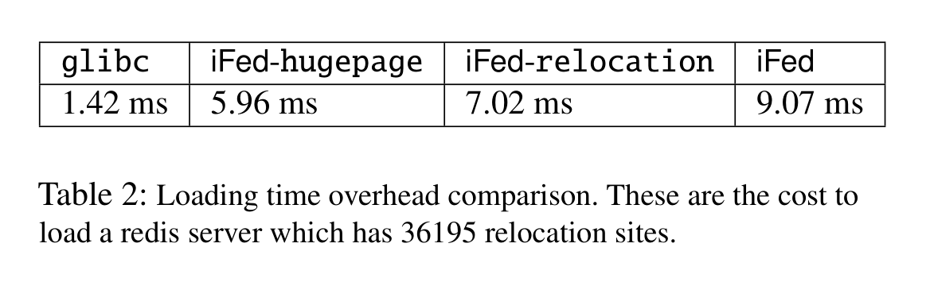
Relocation Branch Elimination
引入的问题：
3、加载时的开销问题
(1) For applications that already require a modified loader to provide new functionalities, they do not suffer more extra launch costs after switching to iFed
（需要增加硬件支持功能的，无所谓，都得有这个开销）
(2) For long-running services, such as web server and database, the one-time overhead during the startup is always negligible
（长期运行的服务进程，那更无所谓这些启动开销）
(3) For short-lived tasks in high churn environments, we can explore process template and in-memory caching technology [36] to fork processes from an initialized template
（需要频繁启动的短生命周期的，可以试试用进程模板）

Slide 21
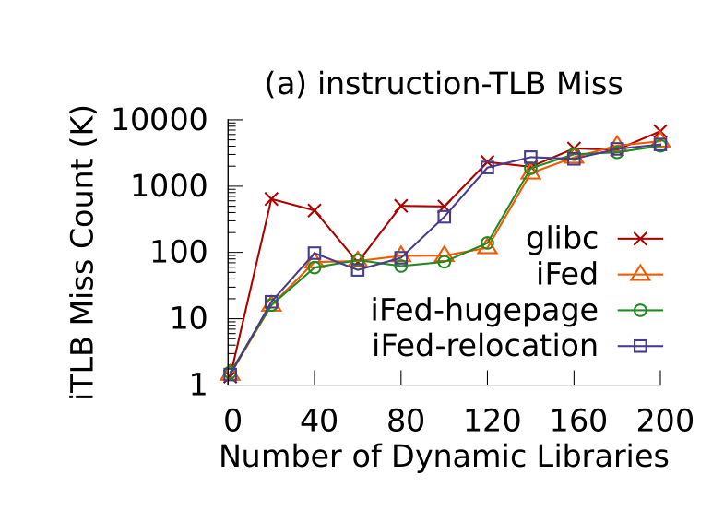
Evaluation
the working set is fixed at 256 KB
glibc
the system default dynamic loader.
(2) iFed–hugepage
iFed with only dynamic library concatenation pass.
(3) iFed–relocation
iFed with only relocation branch elimination pass.
(4) iFed
iFed with both optimization passes.
注意y轴的LOG

Slide 22
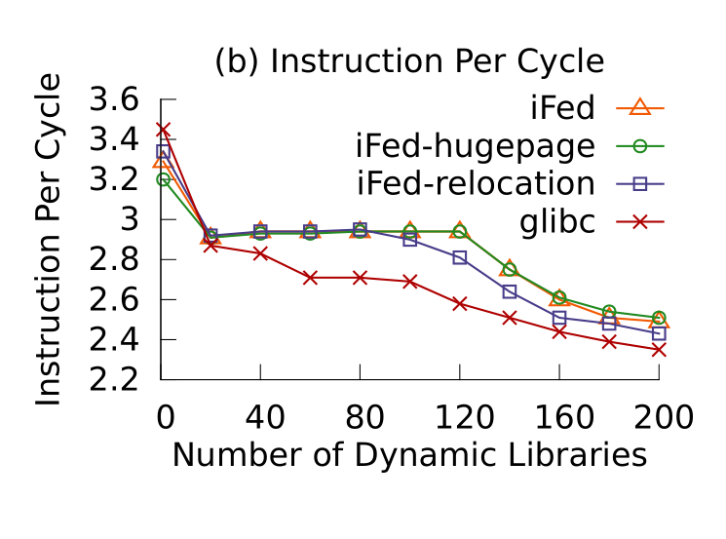
Evaluation
这边看上去只用hugepage和iFed的差别不是很大

Slide 23
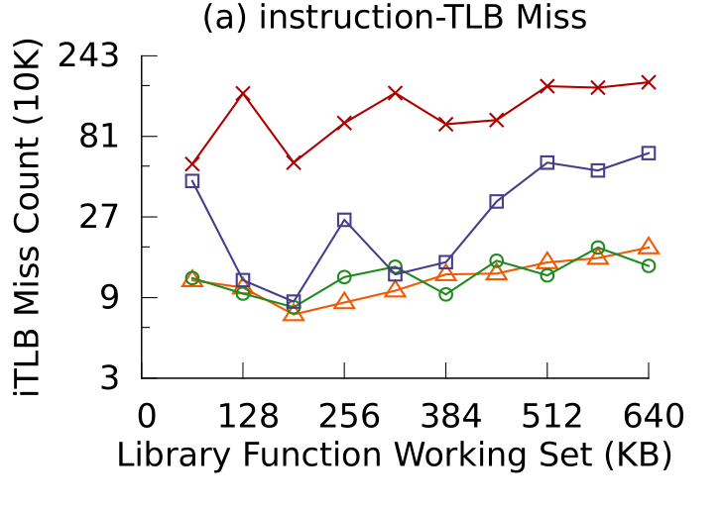
Evaluation
the number of dynamic library is 100
同样注意y轴取对数

Slide 24
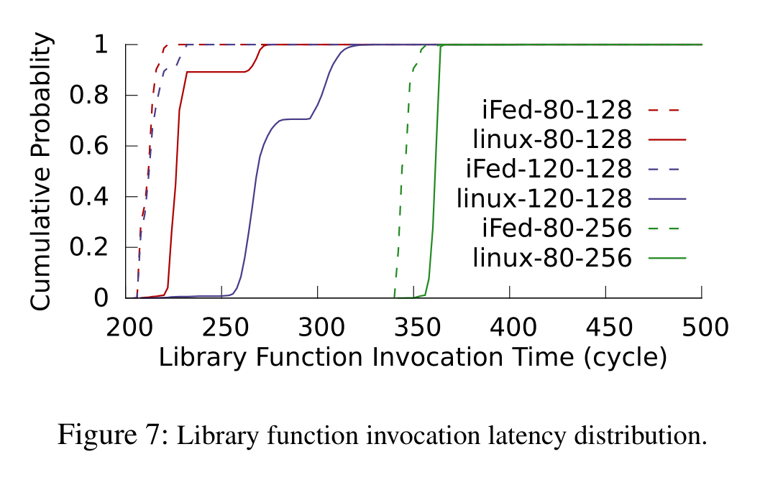
Evaluation

Slide 25
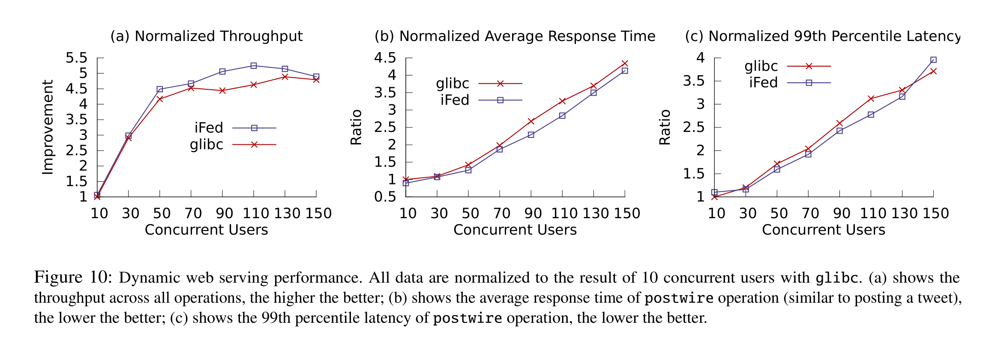
Evaluation

Slide 26
谢谢大家

